Slide 1
Biomedical system analysis, modelling and control-robot assisted stroke / and ankle rehabilitaion
Julia Torresan-Mann : 14264598
Wenjing He - 13015704
Gokula Balan – 24690378
Amaya - 24856421

Slide 2
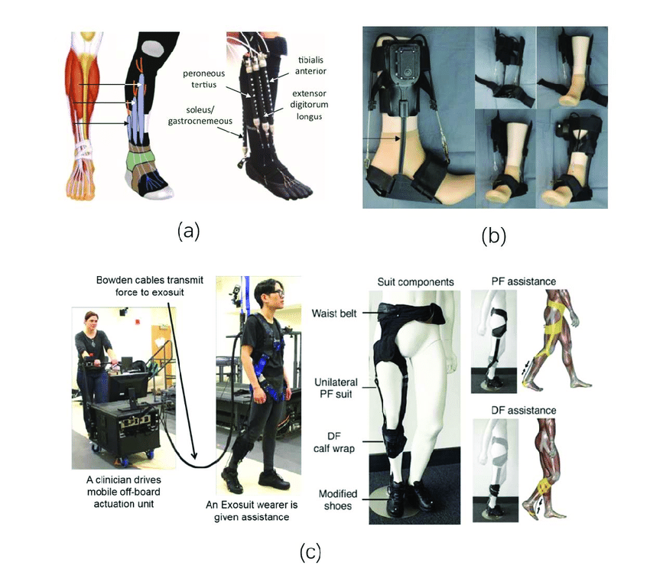
AIM
Real-Time Servo Motor Control
Mechanical Integration for Rehabilitation

Slide 3
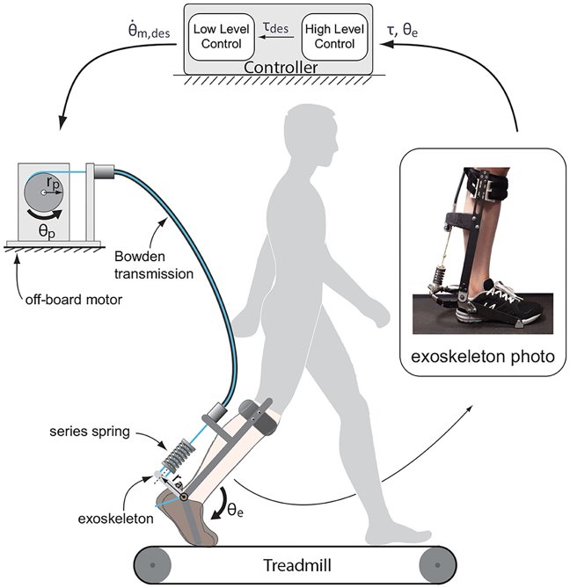
PROJECT SPECIFICATION
Advanced Motion Tracking with EMG Signals
Adaptive Treatment Protocols​
Comprehensive Movement Exercises and Gait Training Modules
Interactive Feedback Mechanisms for Patient Engagement
Stringent Safety Standards Implementation

Slide 4
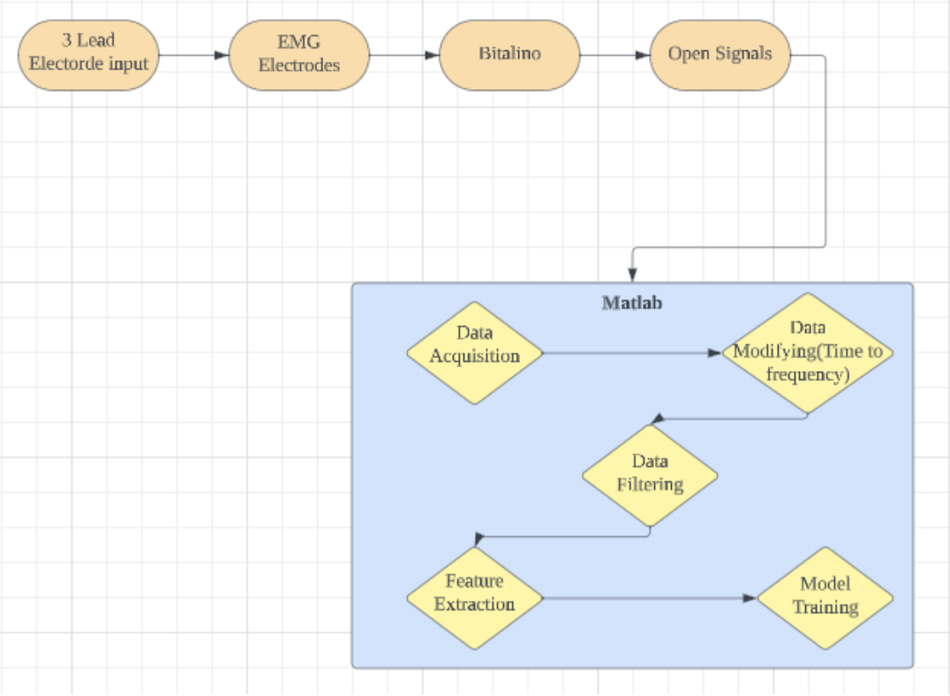
METHODOLOGY
The methodology involves collecting the EMG data signals then data acquisition, filtering, feature extraction, and machine learning-based data classification.
Notes:
The purpose of this project is to design an EMG circuit to effectively collect and filter data. We are using the EMG system to measure and record muscle electrical activity to rehabilitate stroke paitent ankle movements. Using electrodes, bitalino kit, mat lab for classifictaion, filtering and testing then a servo motor for real time data.
The methodology for the project involves several key steps. Data acquisition is the initial phase, focusing on capturing EMG signals from specific muscle groups (which will be discussed in later slides) associated with ankle movements. After data acquisition, data analysis and filtering are performed, which includes using notch and bandpass filters to eliminate unwanted frequencies. Data classification is a pivotal stage where relevant features are extracted, and machine learning algorithms are employed for accurate categorization of the data. This process aids in customizing the rehabilitation program for individual patients. The testing phase assesses the performance of the system, with both offline and real-time testing to ensure that the system meets the desired accuracy levels.

Slide 5
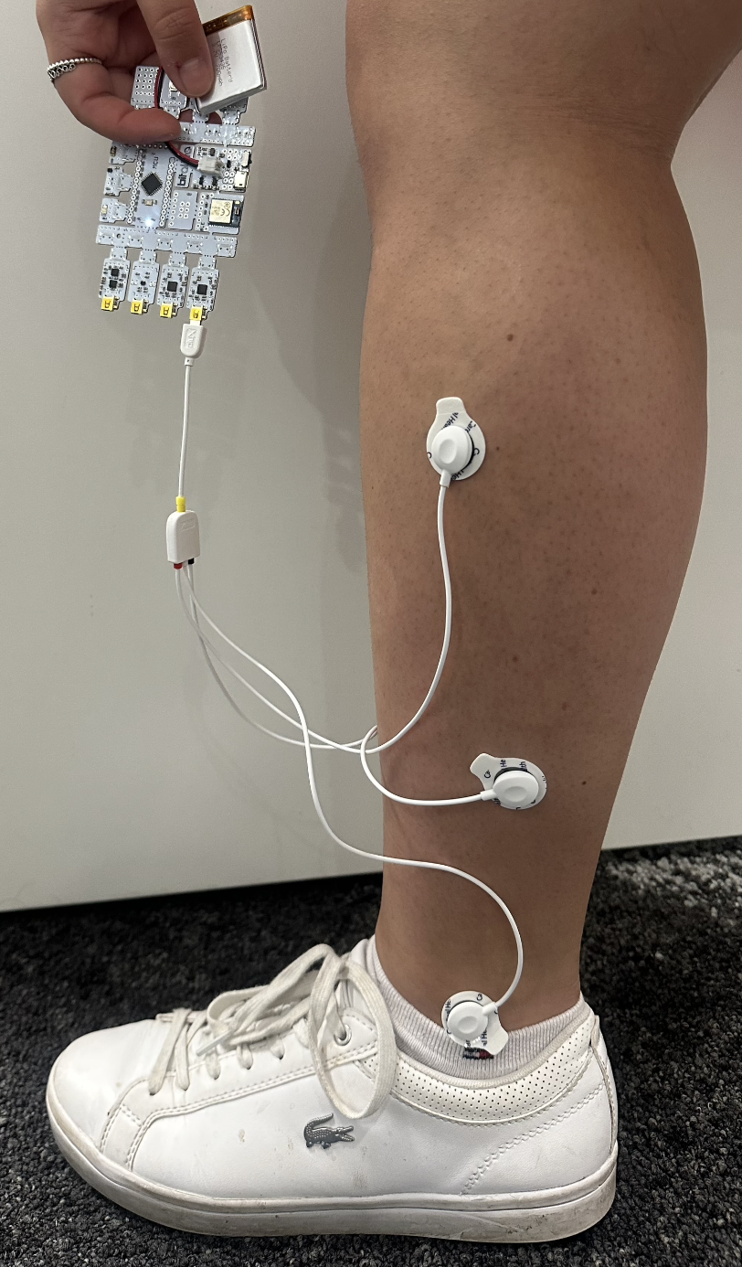
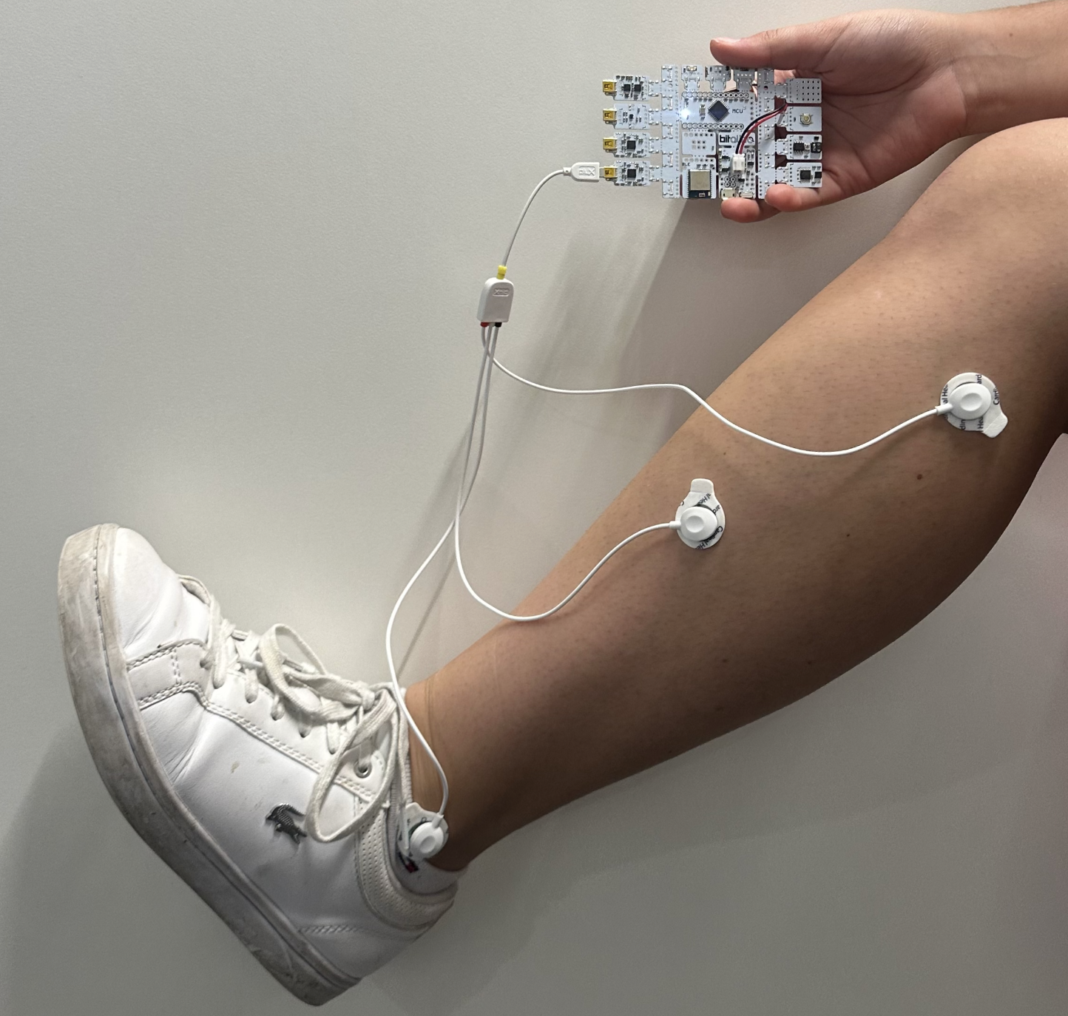
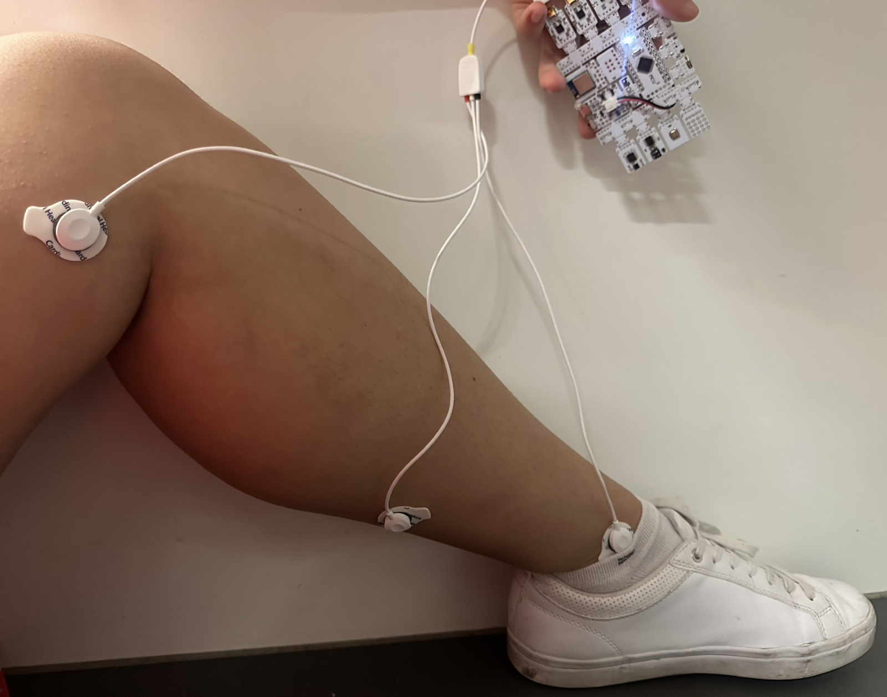
EMG Electrode Placement
Dorsiflexion
Plantar flexion
Relaxed position
Notes:
Movement for stroke affected patients is limited with only a few degrees of freedom. In that dorsiflexion (DF) and plantar flexion (PF) (upward and downward movement of the ankle) are the most important type of movement needed for them to get back to some level of walking. The electrode placements that were used are consistent with literature reviews. Here, we used 3 lead emg electrodes connected to bitalino to collect the signal of movement and the data is shown in the next slide. We look 10 sets of signal in each position of ankle holding it for a minimum of 5 seconds.

Slide 6
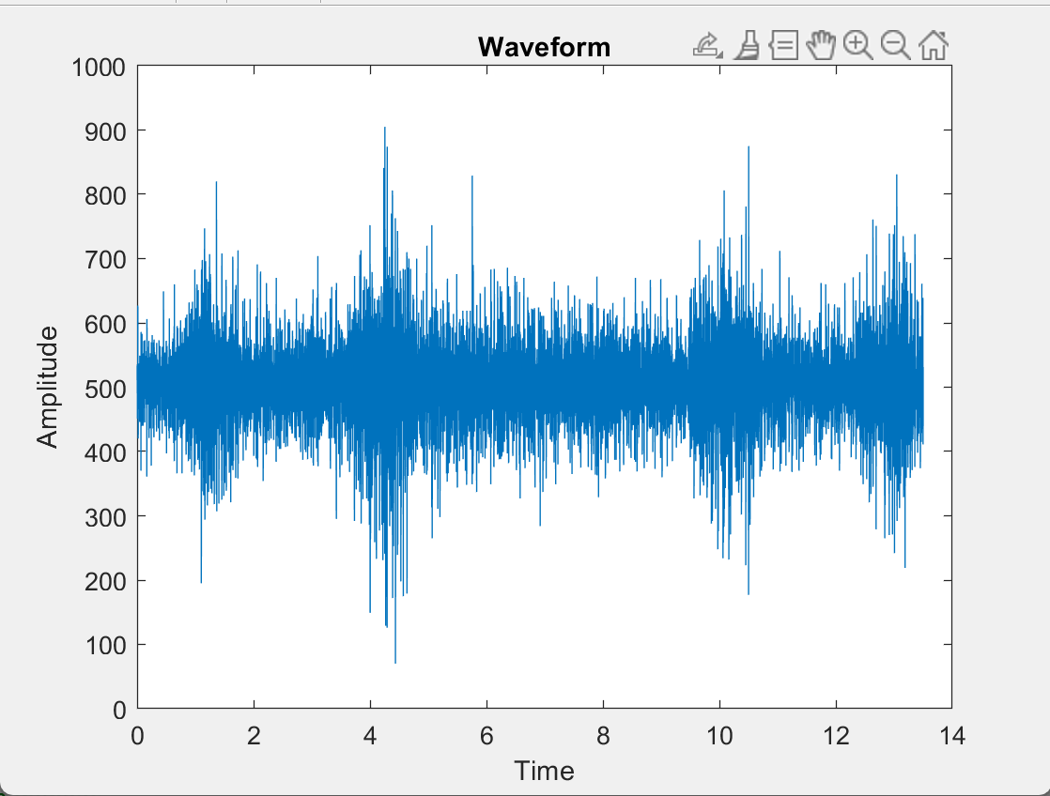
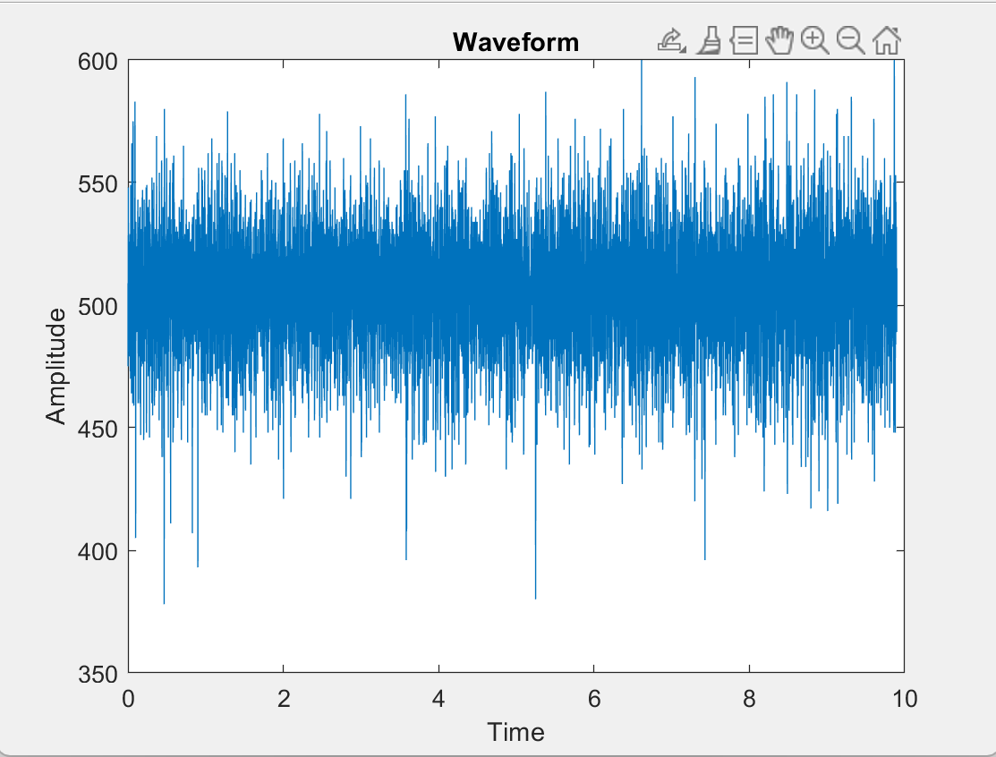
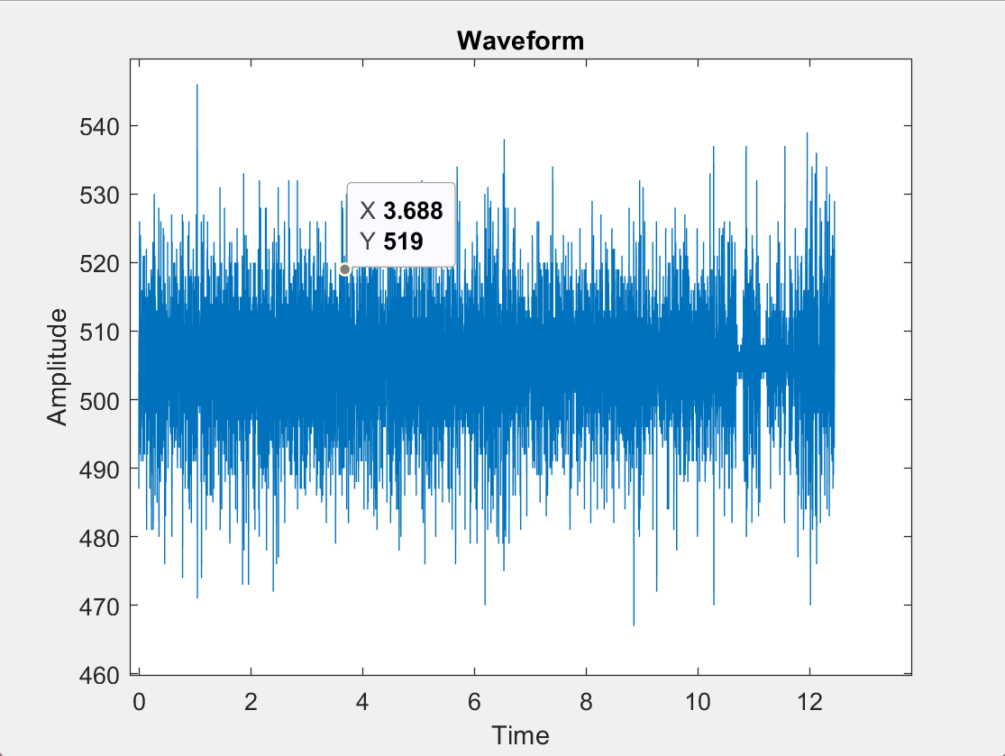
DATA ACQUISITION
Raw Signal
Dorsi flexion
Plantar flexion
Rest position

Slide 7
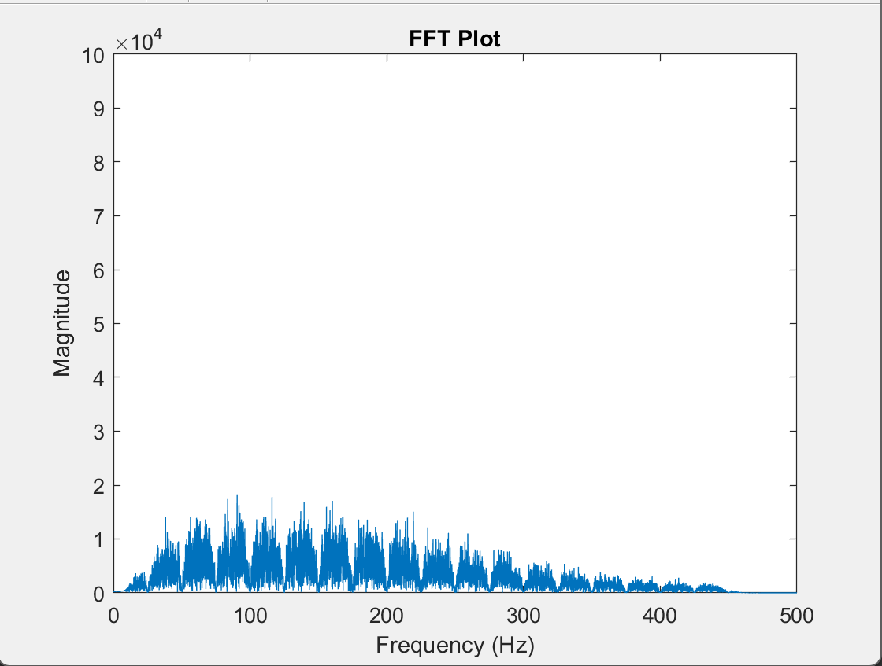
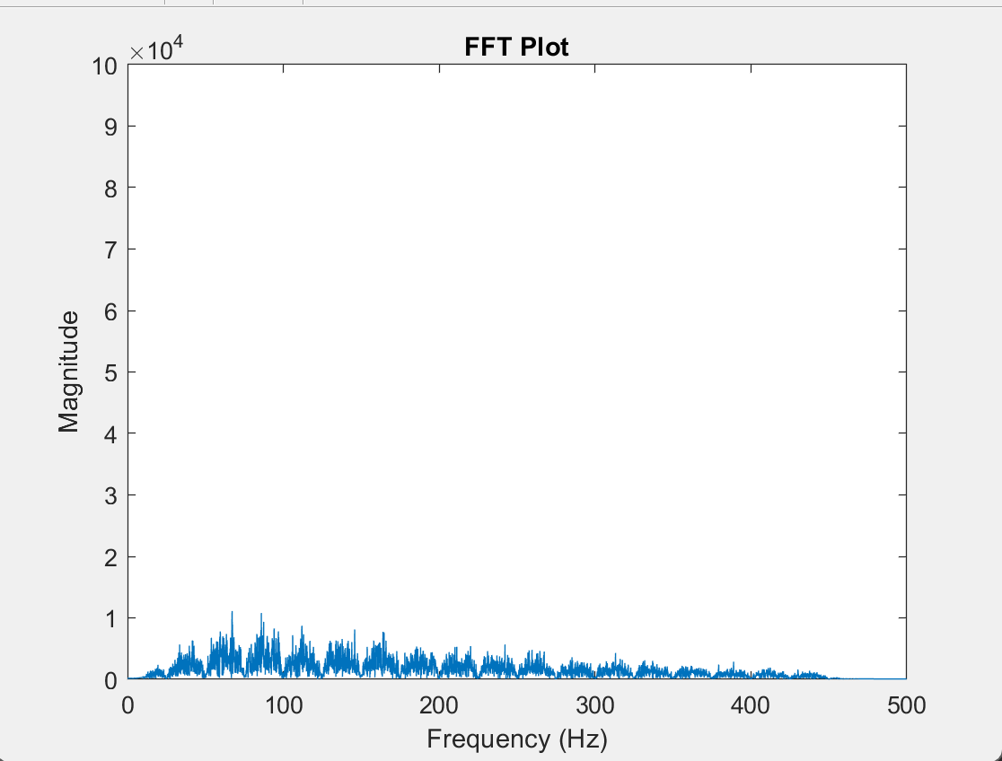
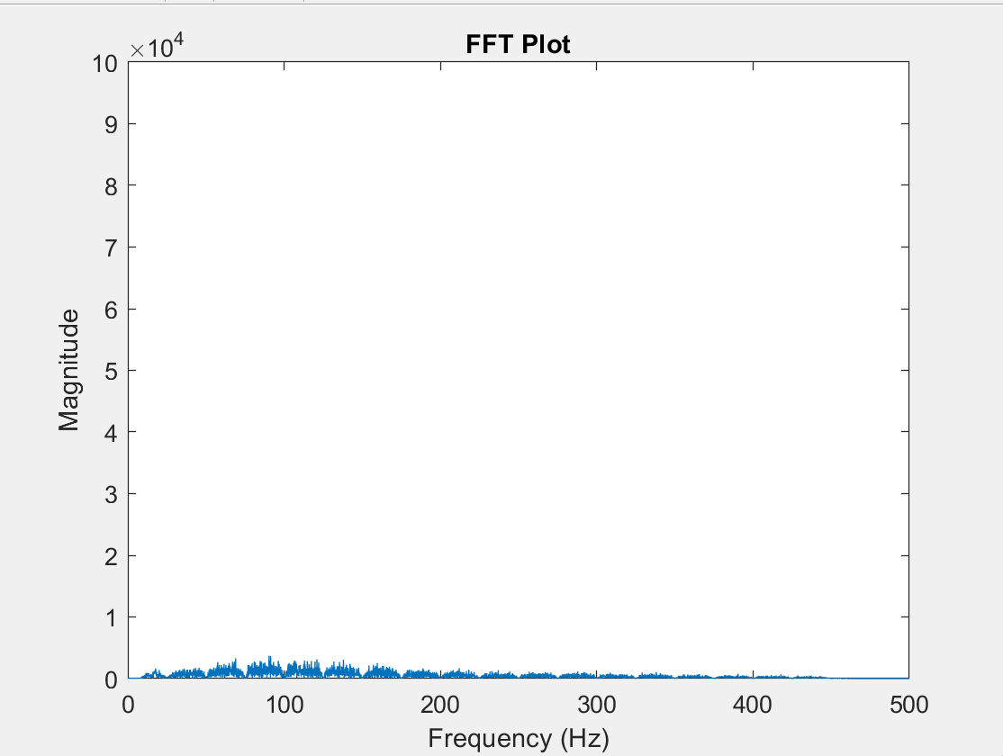
Filtered signal
Dorsi flexion
Plantar flexion
Rest position

Slide 8
FEATURE EXTRACTION
The features extracted are
Root Mean Square (RMS),
Variance (VAR), Mean Absolute Value (MAV),
Standard Deviation (SD),
Zero Crossing (ZC),
Integrated EMG (IEMG),
Simple Square Integral (SSI),
Waveform Length (WL),
Willison Amplitude (WA)
and Slope Sign Change (SSC).

Slide 9
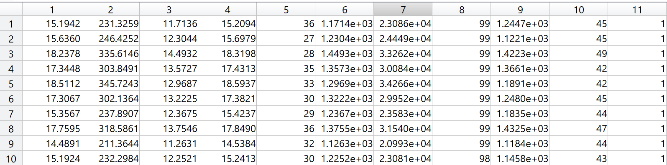
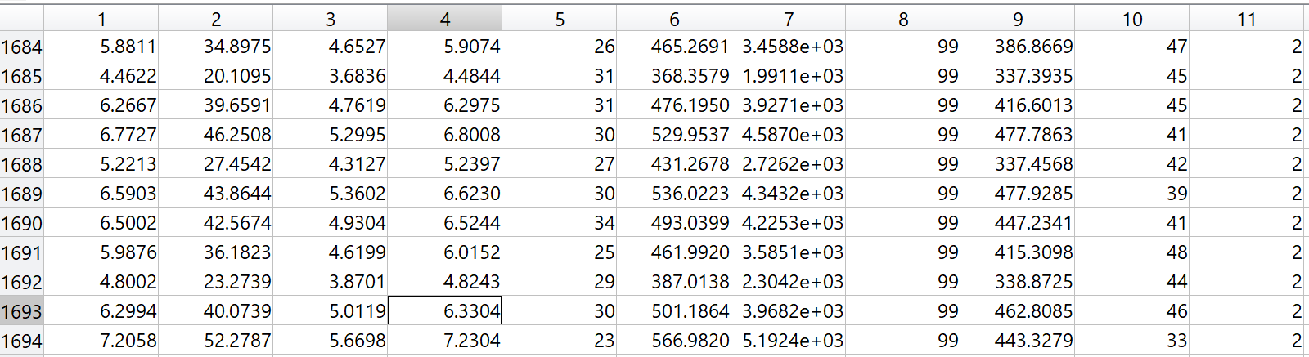
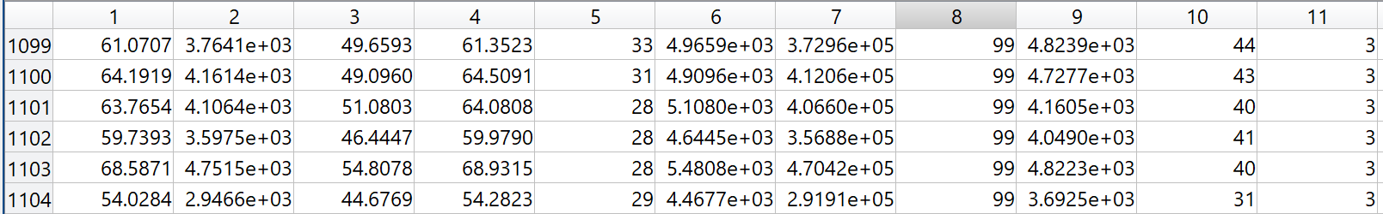
FEATURE EXTRACTION
rms_ feature | var_ feature | mav_ feature | sd_ feature | zc_ feature | iemg_ feature | ssi_ feature | wa_ feature | wl_ feature | ssc_ feature | movement value

Slide 10
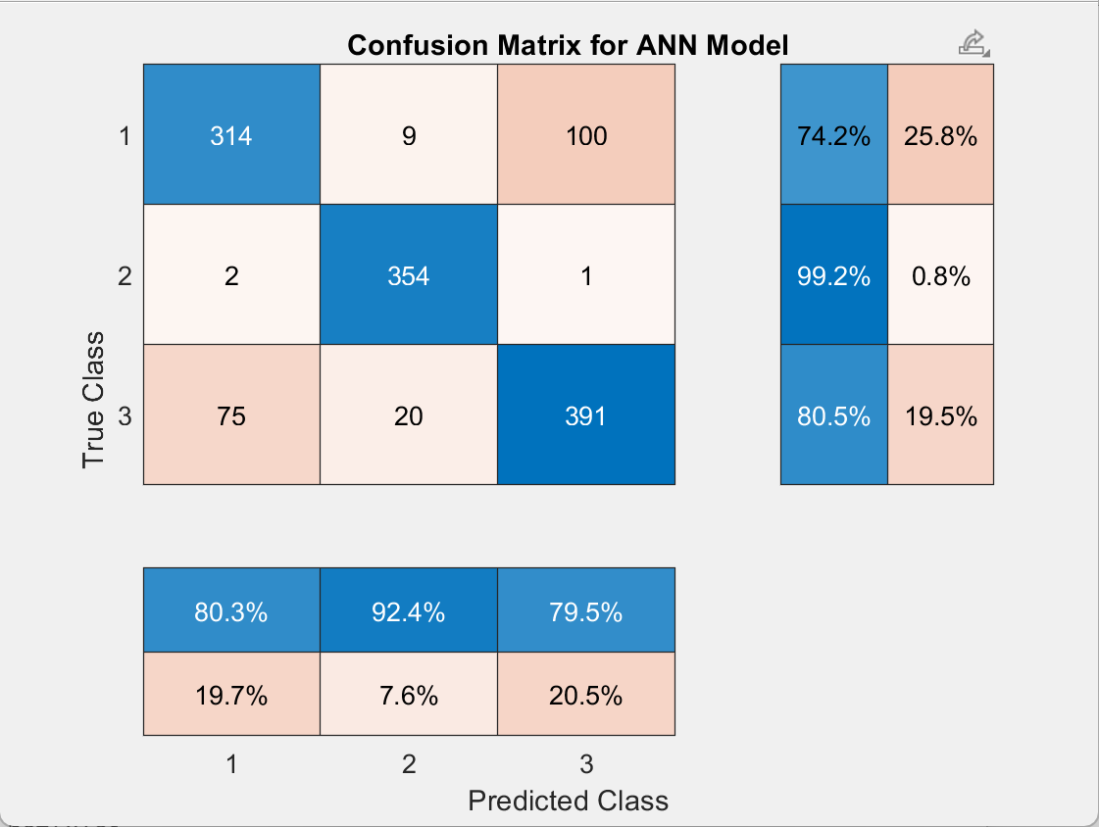
MODEL TRAINING

Slide 11
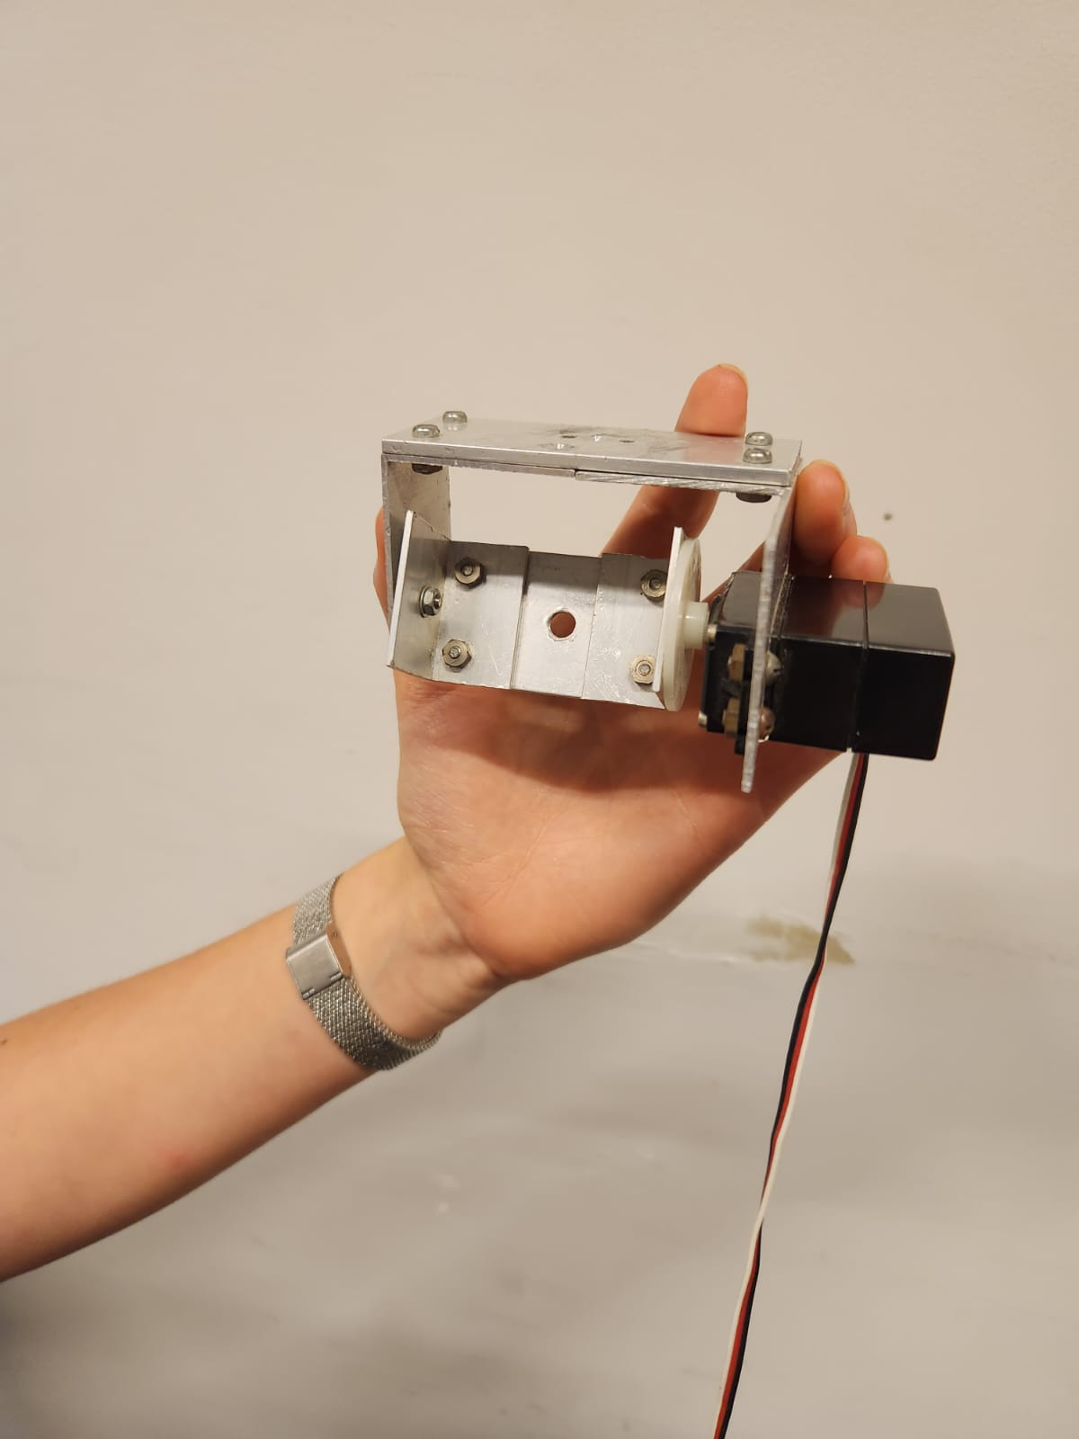
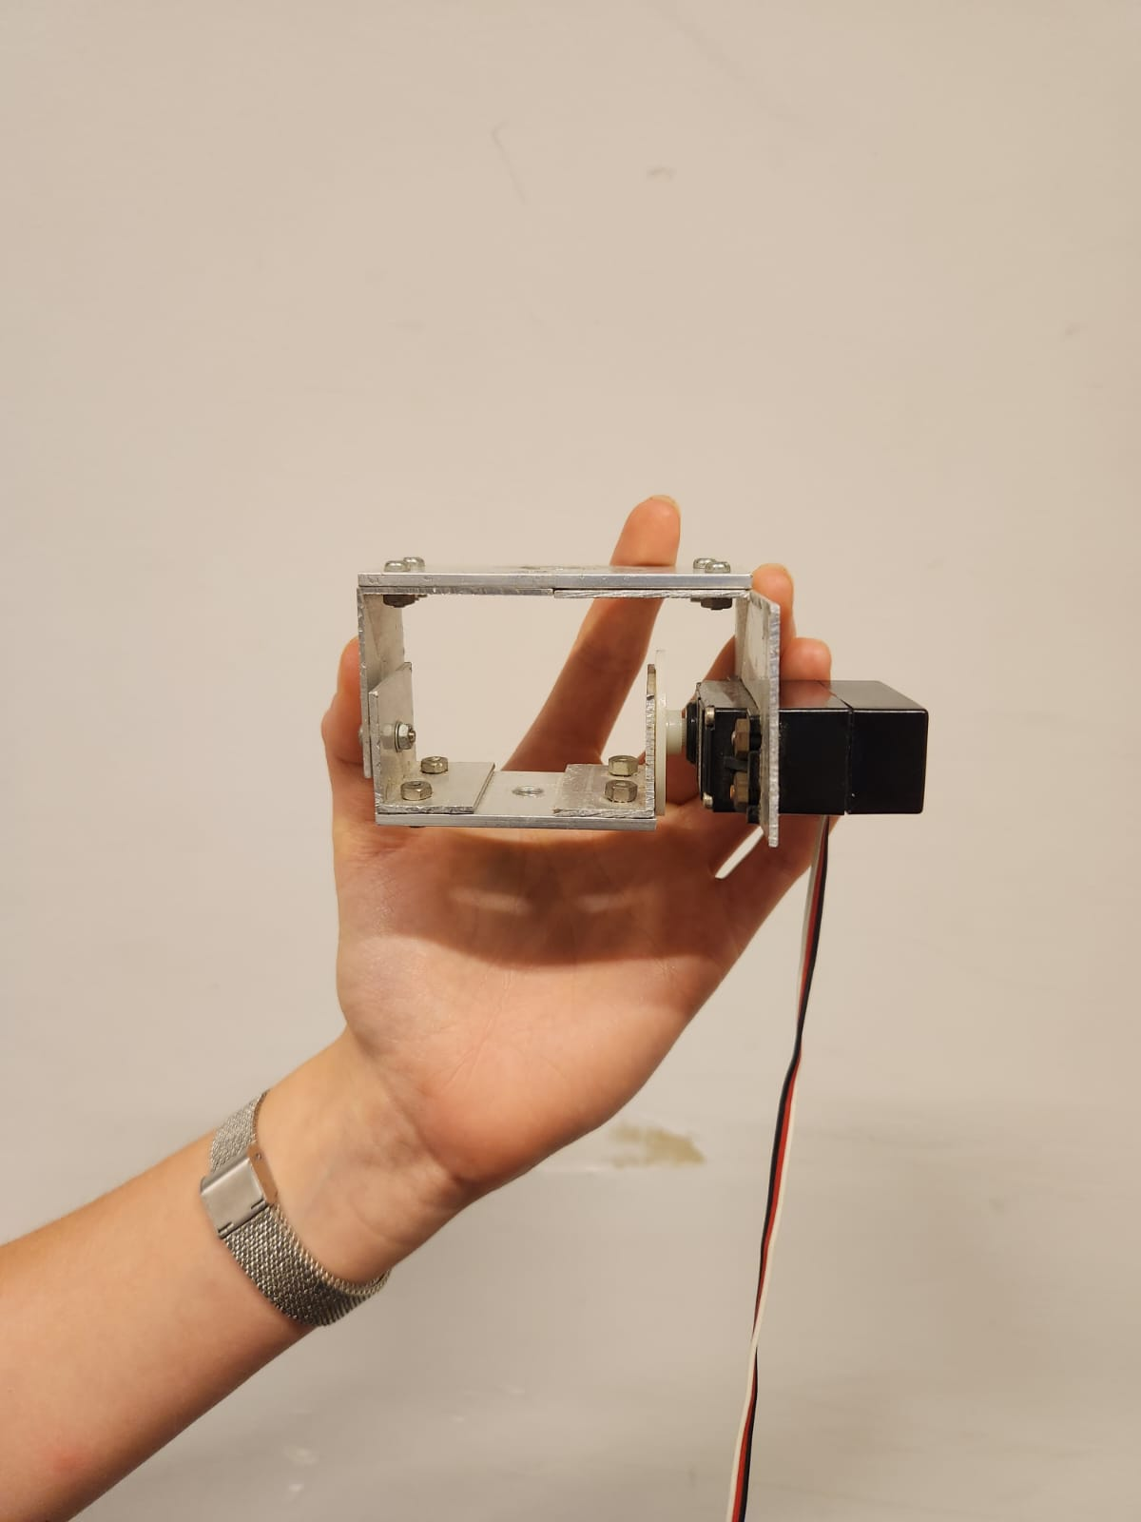
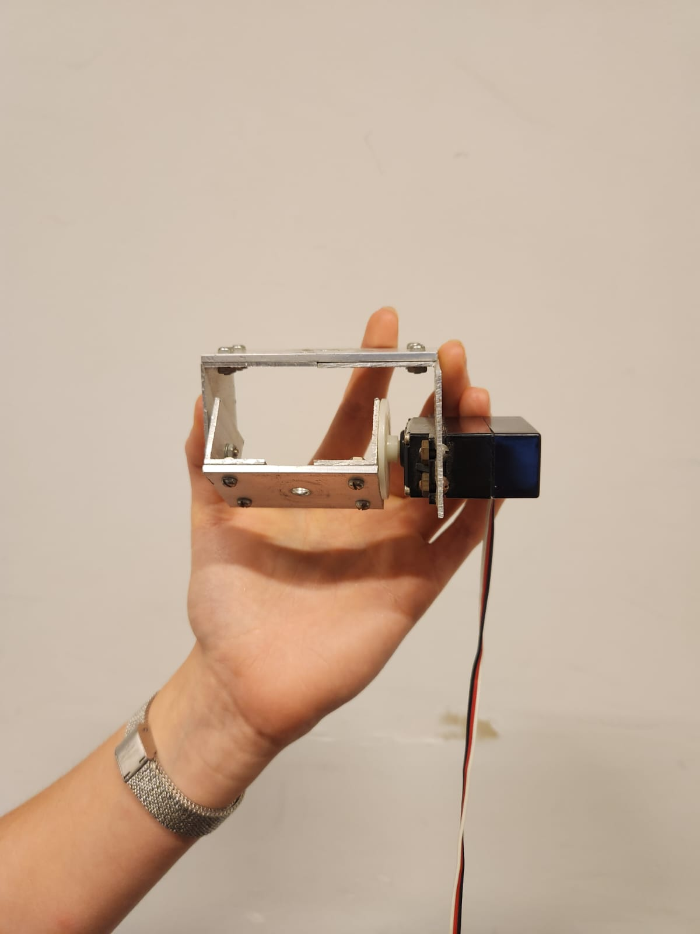
Servo Motor Calibration
3 positions:
45 degree -> plantar flexion
0 degree -> Relaxed position
-45 degree -> Dorsiflexion
Servo motor
Matlab
Arduino uno
Notes:
In Phase 1 of our project, I was responsible for the crucial task of calibrating the servo motor. Our primary goal in this phase was to create a system where the motor could recognize specific movements and respond by sending signals (1, 2, or 3) and adjusting its position accordingly. To accomplish this, I undertook a series of experiments to fine-tune the calibration process.
Initially, I attempted to connect the servo motor to both Arduino and MATLAB, but eventually decided to establish a direct connection with MATLAB for more precise control. Once the servo motor was integrated with MATLAB, I proceeded with the calibration process to determine the correct angles that corresponded to the three distinct movements we aimed to capture.
Through these experiments, I successfully identified the accurate calibration values for the three key positions:
1. 45 degrees: Representing plantar flexion.
2. 0 degrees: Indicating the relaxed position.
3. -45 degrees: Signifying dorsiflexion.

Slide 12
REAL TIME
First trials : with one file
Read the file of an "unknown" movement
Filter de Data
Extract features
Predict the movement using the trained NN
Move the servo motor accordingly
Second trials : connecting directly to BITalino Uno
Tried changing the recorded file by real time acquisition file
Using BITalino Toolbox
Notes:
In our project's next phase, we aimed to introduce real-time data acquisition and observe the servo motor's immediate response. However, before venturing into real-time operation, we decided to utilize the data collected during the second phase of our project. Initially, we began by reading the data related to an unfamiliar motion pattern. Subsequently, we applied a notch and band-pass filter to the data, followed by feature extraction from the filtered signals. This set of features was then input into a neural network model, which generated predictions for the intended movements. These predictions were then used to control the servo motor's actions, ensuring it moved in sync with the anticipated motion. After implementing this process for a few different data files, we observed favorable results.
With the successful offline testing, we proceeded to the real-time implementation. To achieve this, we devised a method to transition from using predefined data files to capturing real-time data. We accomplished this transition by creating a Bitalino object (denoted as 'b'), initiating a background data acquisition process, allowing for a 20-second data collection period, capturing the acquired data into a designated variable, halting the background acquisition process, and finally, properly closing the Bitalino object. The real-time data was subsequently processed in a manner consistent with our previous approach.

Slide 13
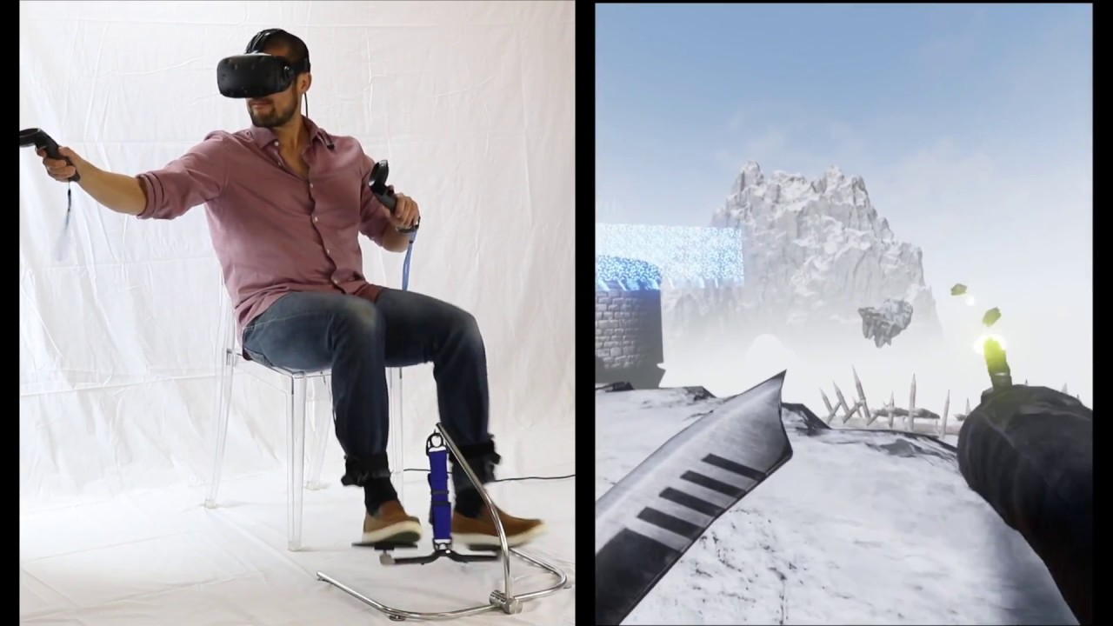
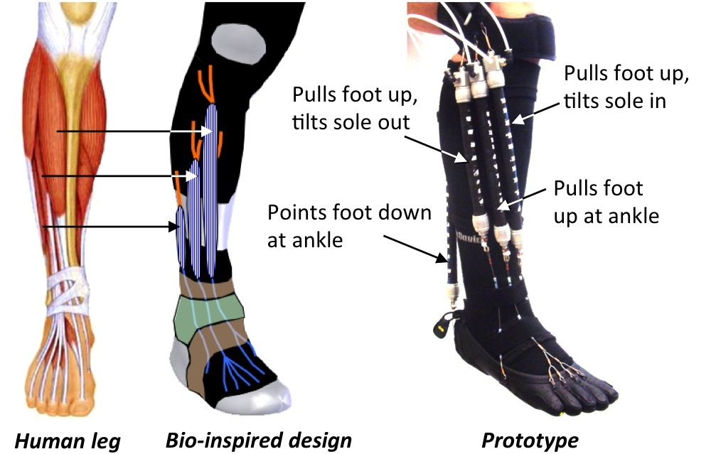
NOVEL IDEA(Future)
· Virtual Reality(VR) Gamification for Enhanced Rehabilitation
· Bioinspired Robotic Designs for Enhanced Rehabilitation

Slide 14


PROJECT OVERVIEW
DATA ACQUISITION + FILTERING + FEATURE EXTRACTION
EMG SYSTEM
STROKE/ANKLE REHABILITATION
MODEL TRAINING + REAL TIME

Slide 15
THANKS

Slide 16
REFERENCES
EMG Practicum 1: Electrode location and placement. (n.d.). https://www.dnbm.univr.it/documenti/ OccorrenzaIns/matdid/matdid174356.pdf
Peng, Z., & Huang, J. (2019, July). Soft Rehabilitation and Nursing-Care Robots: A Review and Future Outlook. ResearchGate. https://www.researchgate.net/figure/Soft-rehabilitation-and-nursing-care-robots-based-on-tendon-driven-in-lower-limb-a-is_fig2_334817746
SitFlow VR Virtual Reality leg Foot Tracking simulates natural movement. (2016). Www.youtube.com. https://www.youtube.com/watch?v=QlBn7P8HR6M
University, C. M. (2014, January 21). Bio-inspired robotic device could aid ankle-foot rehabilitation, researcher says (w/ video). Medicalxpress.com. https://medicalxpress.com/news/2014-01-bio-inspired-robotic-device-aid-ankle-foot.html
Zhang, J., & Collins, S. H. (2021). The Iterative Learning Gain That Optimizes Real-Time Torque Tracking for Ankle Exoskeletons in Human Walking Under Gait Variations. Frontiers in Neurorobotics, 15. https://doi.org/10.3389/fnbot.2021.653409

